Slide 1




2
Working with Blocks of Data
Prepared By :
Said Fawzy
Manager of Information Center
Tendering Department
Arab Contractors

Slide 2

1
Navigations and Editing Features
2
Sorting and Filtering

Slide 3
1
Navigations and Editing Features

Slide 4
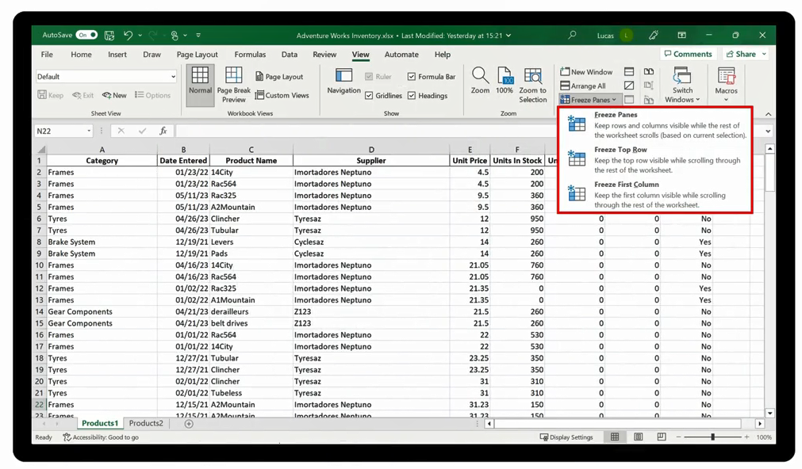
Freeze Panes

Slide 5
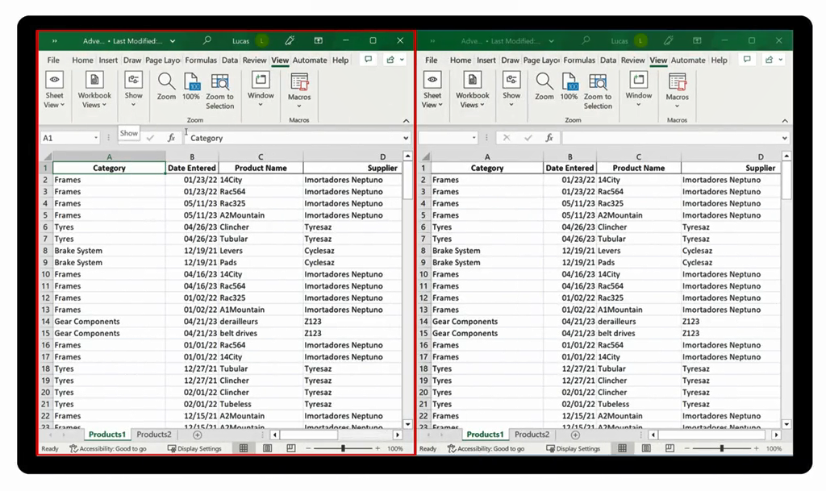
New Window

Slide 6
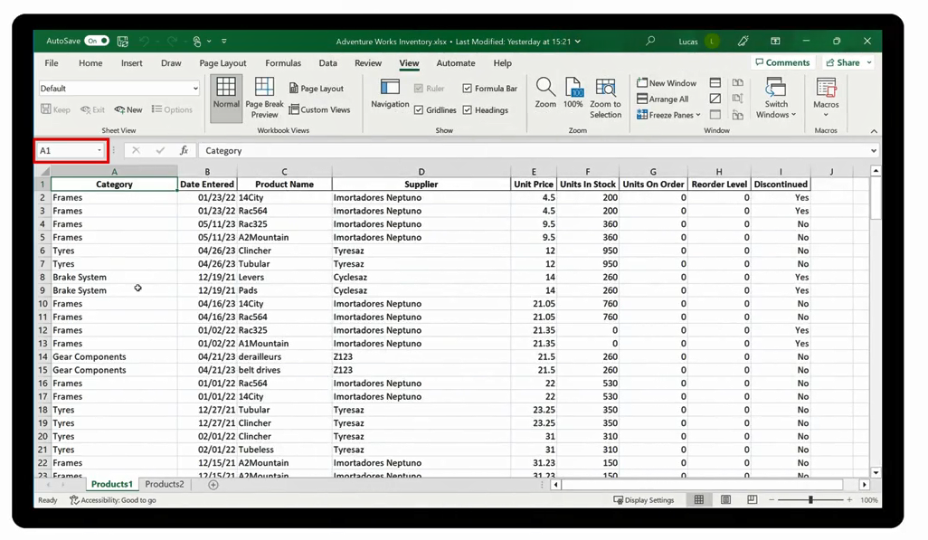
Name Box

Slide 7

Demo 2 A
Navigations and Editing Features

Slide 8

Question 2-1
While editing the Adventure Works file, you turn the first visible row and column in the spreadsheet static. Which one of the following options do you use to complete this task?
A. Freeze First Column
B. Freeze Top Row
C. Freeze Panes

Slide 9

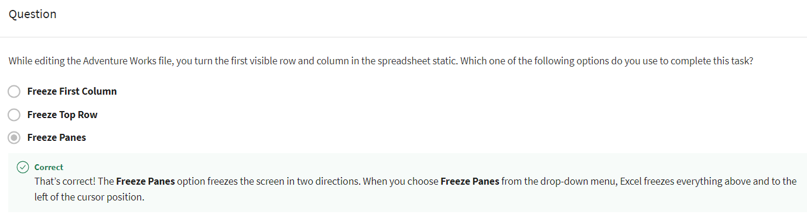
Explanation

Slide 10
2
Sorting and Filtering

Slide 11


Slide 12
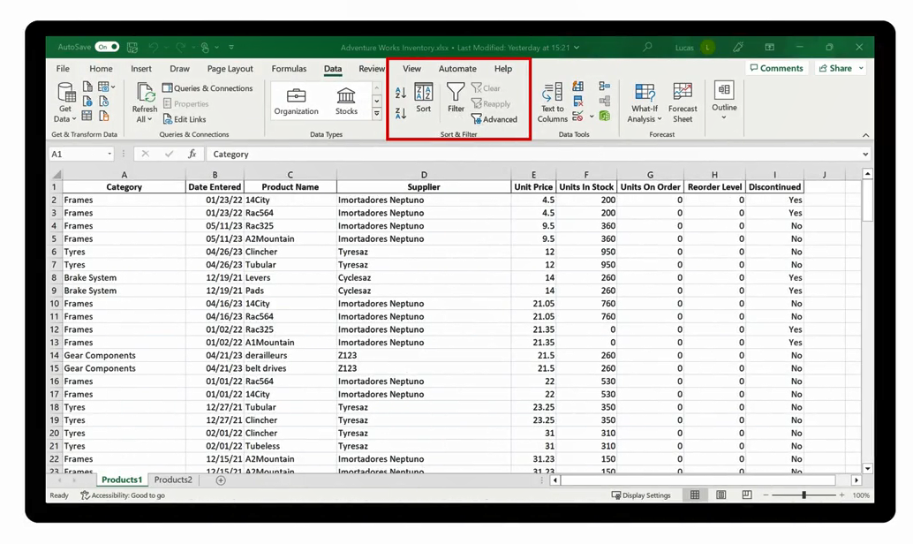
Sorting

Slide 13
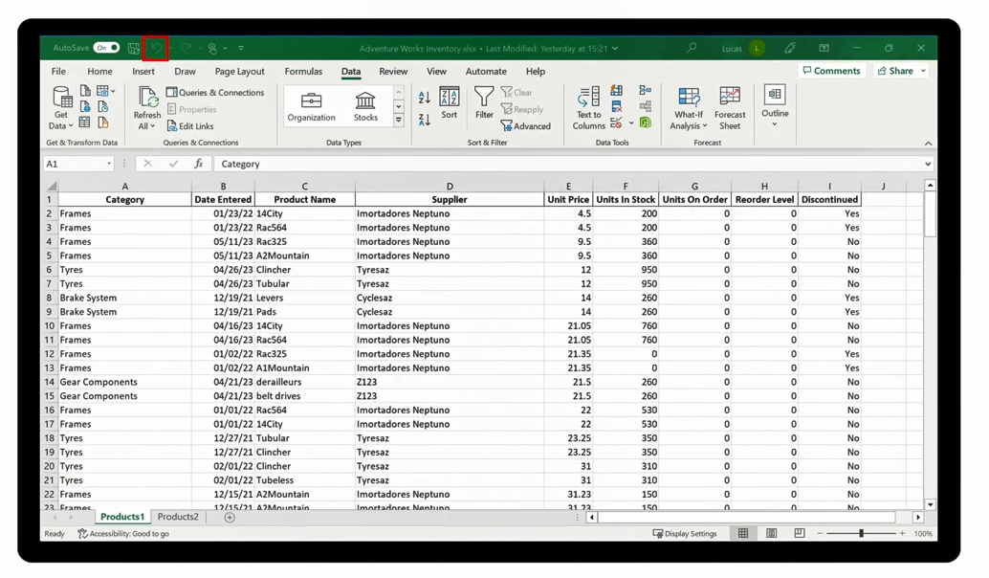
Sorting

Slide 14
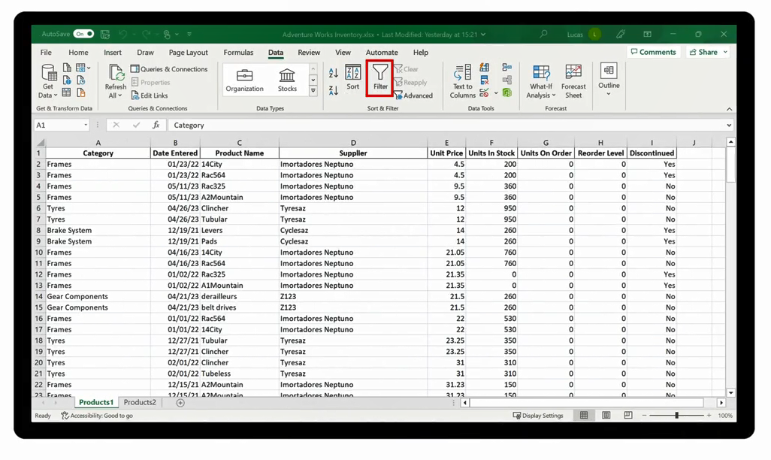
Filtering

Slide 15
Filtering

Slide 16
Demo 2 B
Sorting and filtering data in Excel

Slide 17
Question 2-2
True or False: You need to specify the key for a Sort when using the Sort Ascending choice by highlighting the relevant column.
True
False

Slide 18
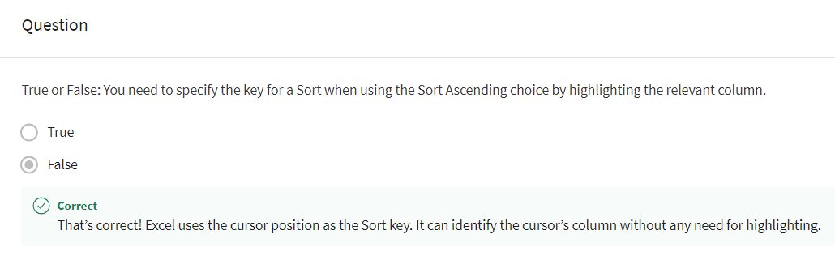
Explanation

Slide 19

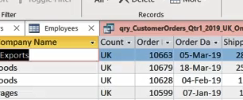
Exercise 2A: Sorting data.

Slide 20

Exercise Questions
Question 1
In the exercise, you sorted the Products worksheet data by the Product Name information stored in column C. Which of the following steps did you perform first, so that data would be sorted when you selected the Sort Ascending choice?
Select column C by selecting the column initial.
Select Product Name from a drop-down list.
Select any cell in column C.

Slide 21
Exercise Questions
Question 1
In the exercise, you sorted the Products worksheet data by the Product Name information stored in column C. Which of the following steps did you perform first, so that data would be sorted when you selected the Sort Ascending choice?
Select column C by selecting the column initial.
Select Product Name from a drop-down list.
Select any cell in column C.
The Sort Ascending option is a shortcut choice. Excel looks at the column that the cursor is in and uses the content of that column as the key to the sort. The cursor can be on any cell in the column.

Slide 22
Exercise Questions
Question 2
You were asked to sort the data first by Supplier and then by Units in Stock. Which choice did you select on the Data ribbon to perform this?
Sort
Sort A to Z
Sort Z to A

Slide 23
Exercise Questions
Question 2
You were asked to sort the data first by Supplier and then by Units in Stock. Which choice did you select on the Data ribbon to perform this?
Sort
Sort A to Z
Sort Z to A
The Sort choice on the Data ribbon allows you to customize what Excel is sorting by. It also allows you to create multiple levels of sort which run simultaneously.

Slide 24
Exercise Questions
Question 3
True or False: You used Sort to sort the data using two columns with a first-level sort by Supplier and a second-level sort data by Units in stock. This meant that when the sort was complete, the Supplier entries were no longer in alphabetical order.
True
False

Slide 25
Exercise Questions
Question 3
True or False: You used Sort to sort the data using two columns with a first-level sort by Supplier and a second-level sort data by Units in stock. This meant that when the sort was complete, the Supplier entries were no longer in alphabetical order.
True
False
! In a multi-level sort, the data is sorted first by the first level sort. This sort would have grouped the supplier's rows together. The second-level sort sorts these rows within the supplier groupings. The suppliers' names would therefore still be in alphabetical order.

Slide 26
Exercise 2B: Filtering data

Slide 27
Exercise Questions
Question 1
You have five filters in place on the data in your worksheet. What is the quickest way to remove all filters and restore the full display of data?
Use the Undo button.
Use the Clear option on the Data ribbon.
Use the Clear filter from choice in each filter drop-down.

Slide 28
Exercise Questions
Question 1
You have five filters in place on the data in your worksheet. What is the quickest way to remove all filters and restore the full display of data?
Use the Undo button.
Use the Clear option on the Data ribbon.
Use the Clear filter from choice in each filter drop-down.
The Clear choice which is to the right of the Filter button on the Data ribbon is the quickest way to remove all filters in place.

Slide 29
Exercise Questions
Question 2
You are working with a large block of data. You applied a filter but there are still a lot of rows visible. How can you determine how many results you have found?
Check the bottom-left of the Excel screen.
Check the bottom-right of the Excel Screen.
Check the middle of the status bar.

Slide 30
Exercise Questions
Question 2
You are working with a large block of data. You applied a filter but there are still a lot of rows visible. How can you determine how many results you have found?
Check the bottom-left of the Excel screen.
Check the bottom-right of the Excel Screen.
Check the middle of the status bar.
The bottom-left of the Excel screen will display a message showing how many records were found.

Slide 31
Exercise Questions
Question 3
In the exercise, you selected the Product Name filter to filter and find all the entries relating to mountain bikes. What were your next steps?
You selected Text filter and then begins on the sub-menu.
You selected Text filter and then equals on the sub-menu.
You selected Text filter and then contains on the sub-menu

Slide 32
Exercise Questions
Question 3
In the exercise, you selected the Product Name filter to filter and find all the entries relating to mountain bikes. What were your next steps?
You selected Text filter and then begins on the sub-menu.
You selected Text filter and then equals on the sub-menu.
You selected Text filter and then contains on the sub-menu
The Contains option on the Text filter sub-menu allows you to look for a piece of text regardless of its position in the cell entry.

Slide 33


Slide 34

2
Question 1
You want to move quickly to cell S1215 in your worksheet. To achieve this, you type the cell reference into a particular area of the screen and then press enter. What is the area of the screen called in which you type the cell reference?
The Name Box
The Title Bar
The Formula Bar

Slide 35
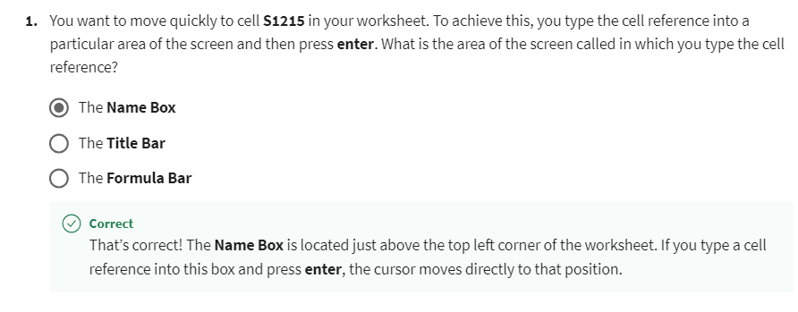
2

Slide 36
2
Question 2
You open an Excel worksheet that contains ten columns of data. The information is filtered, so some of the available data is not visible. How can you identify which heading the data is filtered by?
The Filter arrow drop-down symbol is in bold.
The Filter arrow contains an arrow symbol.
The Filter arrow contains a funnel symbol.

Slide 37
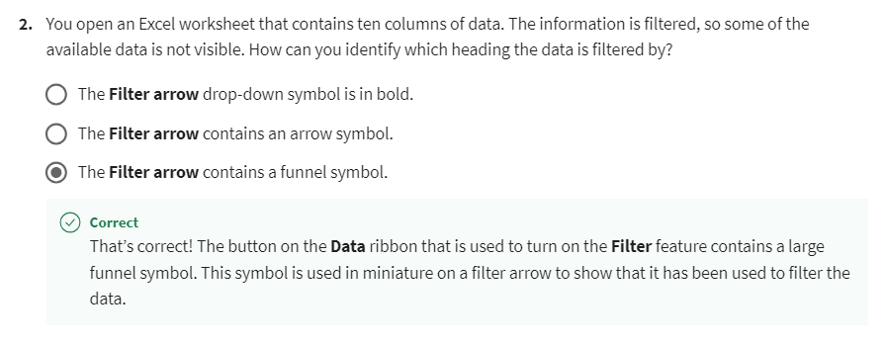
2
Explanation

Slide 38
2
Question 3
Column A in your worksheet contains component names. All twenty-two names have been input as text except for one entry called 11ratchet, which begins with a number. If you were to sort this column in descending order, where would the entry 11ratchet appear?
At the bottom of the column.
In the middle of the column.
At the top of the column.

Slide 39
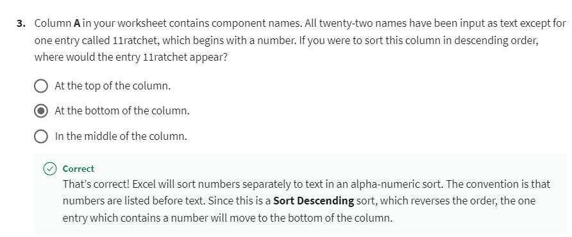
2
Explanation

Slide 40
2
Question 4
Row one in your worksheet contains headings and it is currently visible at the top of the screen. The cursor is on cell B3. Which of the Freeze Panes options must you choose to ensure that the headings remain visible onscreen?
Freeze First Column
Freeze Top Row
C. Freeze Panes

Slide 41
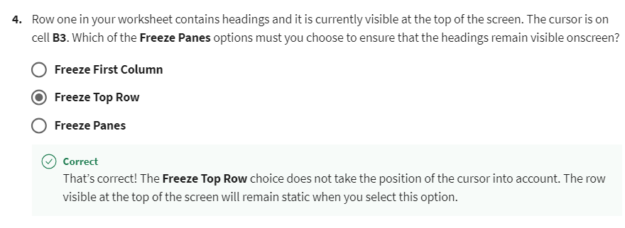
2
Explanation

Slide 42
2
Question 5
True or False: You need to edit only those rows in a spreadsheet that have been shaded yellow. You can use the Filter by color filter option to hide rows that haven’t been formatted in this way.
True
False

Slide 43
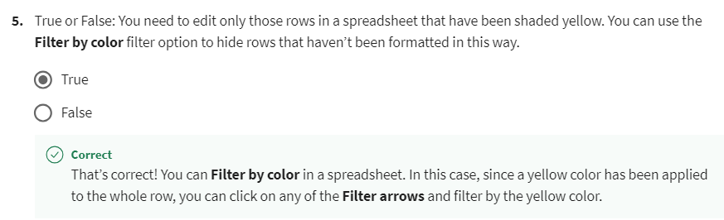
2
Explanation

Slide 44
2
Question 6
When Autosave is switched on, Microsoft Excel automatically assigns a generic name to a new workbook. This name is visible on the Title bar at the top of the Excel window. What can you change within this file name?
The file name and the save location.
Only the file name.
Only the save location of the file.

Slide 45
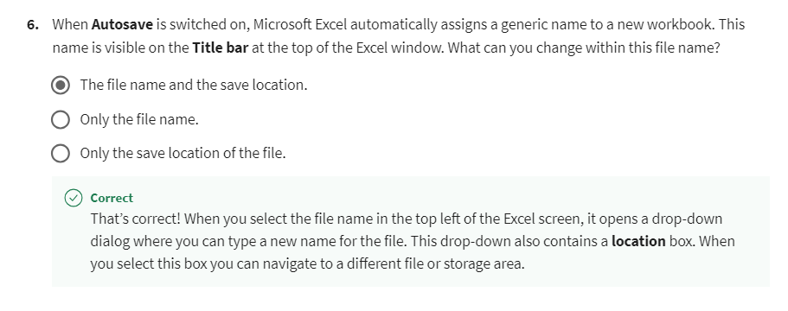
2
Explanation

Slide 46
2
Question 7
You are working with a block of information, and you realize that you need to add a new column to the left of the column that your cursor is in. Which of the following series of steps can you perform to correctly insert the column? Select all that apply.
Select the Home ribbon, select Insert, and then select Insert Sheet Columns.
Click the right mouse button, select Insert, and then select Entire column.
Select the Insert Ribbon, select on Insert, and then select Insert Sheet Columns.

Slide 47
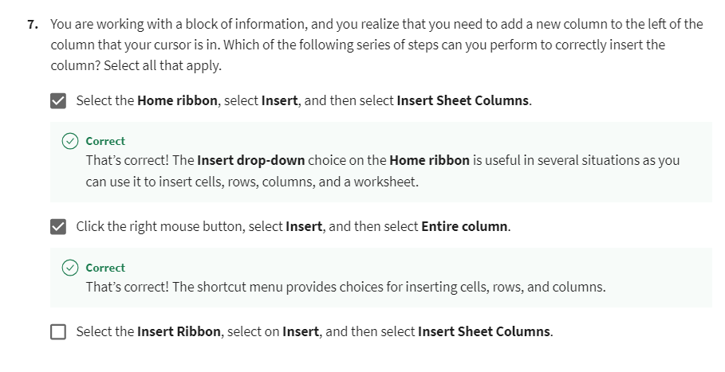
2

Slide 48
2
Question 8
You are entering repeat content in your worksheet. After entering the content several times Excel offers the content as an automatic suggestion. What is this feature called?
Autocomplete
Autofill
Autofit

Slide 49
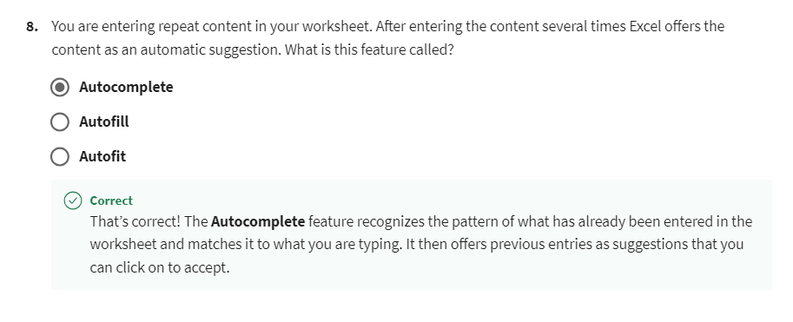
2
Explanation

Slide 50
2
Question 9
You need to present a worksheet to your colleague. However, columns D and E contain confidential data that they cannot be privy to. What option on the Home ribbon can you use to hide these columns during the presentation?
Delete drop-down.
Format drop-down.
Insert drop-down.

Slide 51
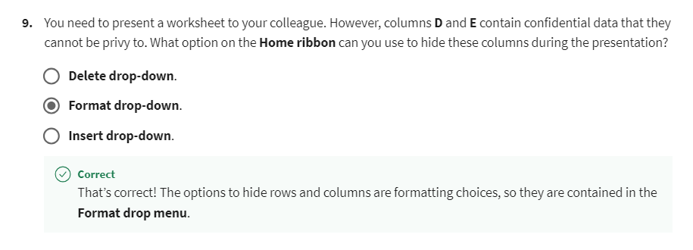
2
Explanation

Slide 52
2
Question 10
You enter numbers into a column. Your entries are displaying a different number of decimal places from those you intended. Where can you locate the increase and decrease decimal buttons to control the number of decimal places displayed?
In the Alignment group on the Home ribbon.
In the Editing group on the Home ribbon.
In the Number group on the Home ribbon.

Slide 53
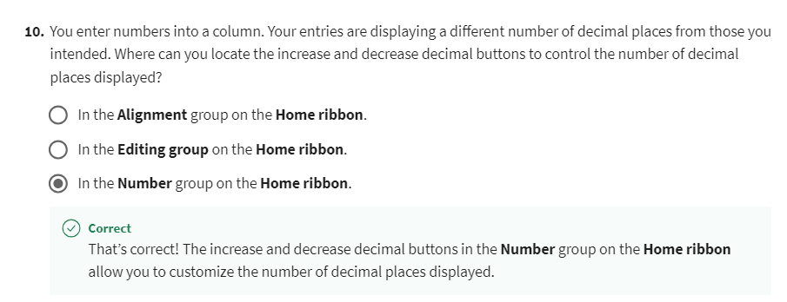
2
Explanation

Slide 54


